Slide 1



Social Innovation Plus – Competence Centres
Barbara Willsberger
L&R Social Research, Vienna

Slide 2


Key Facts
SI PLUS – Competence Centre for Social Innovation
Duration: May 2021 to July 2023
Geographical Coverage: 8 Countries
Lead Partner: L&R Social Research, Austria in cooperation with the project partner arbeit plus
Transnational Partners: IFKA Hungary, ESF Managing Authority Slovakia, SDA Bulgaria
Associated Partners: ENSIE and the ESF MA of Baden-Württemberg, Croatia and Slovenia

Slide 3
What did we do?
Development of a common understanding of the term "social innovation".
Mapping of the status quo and the eco-system: lived practice & good practices, actors, existing knowledge & need for support
Development of common operationalization criteria for social innovation as well as tools for administrative and operational level in the ESF context and beyond.
Establishment of the network structure and implementation of network meetings → Blueprint / Strategy plan for Social Innovation
Regional innovation labs & pitch contest with the aim of re/upscale projects

Slide 4
June- December 2021
Survey
“Mapping” Social Innovation
January 2022 – March 2023
Network Structures, Workshops, etc.
Regional innovation labs
March - July 2023
Tools,Guidelines, Blue Print/ Strategy Plan, Re-/Upscaling
4th July 2023:
Final Event
Kick off
Meetings in the Partner Countries

Slide 5
Social Innovation in ESF+
What does it mean?

Slide 6
Social Innovation in ESF+
Dedicated funding priority: 95% ESF co-funding
Development of a shared understanding and clear framework for implementing SI projects:
  Capacity Building for Intermediate Bodies, stakeholders and project promoters
    AT: SI check list: 4 SI categories to be addressed
    AT: Uniform implementation process described in a guidance document („Wegweiser“) - discussed in advance with the Audit Authority
New Ideas
Meeting Social Needs
Creating Collaborations
Benefiting Society

Slide 7
Mapping Results

Slide 8
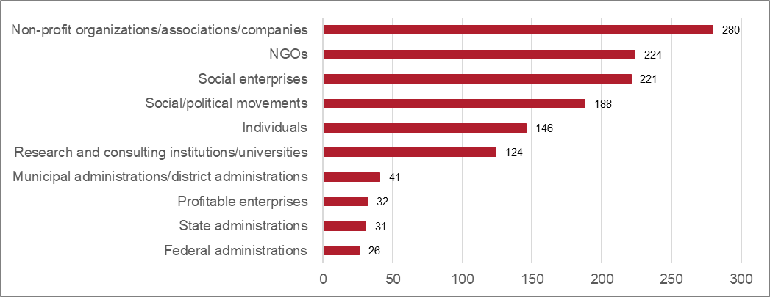
Relevant Stakeholders
Source: L&R Datafile 'Survey: Social Innovation in Austria', 2021 n=346 nmiss= 66; Question: Which actors provide the most important impetus for social innovation?

Slide 9
Role of the Target Group

Slide 10

Key Findings and Conclusions
Missing overarching structure for Social Innovation
Lack of synergies due to „micro-systems“ of Social Innovation in different funds (ESF, EFRE, LEADER, etc.)
Common understanding of Social Innovation is of utmost importance → workshops, conferences, info-sheets
Key role of participatory processes → toolbox
Missing exchange of experience and expertise → use of an untapped potential
Main question remains: How to operationalise coincidence? → Create space and structures for exchange

Slide 11
Achievements and Future Plans

Slide 12
Achievements and Learnings
Social innovation is already lived practice in many areas & there is a lot of potential
→ now it's time to work on suitable structures
Social innovation takes place particularly at the regional level
→ political committment is needed
Social innovation (also) means the involvement of target groups
→ expertise must be built up
There can never be "too much" communication
Notes:
The good exchange with all stakeholders
The continuous work on the common understanding of social innovation
The possibility to get to know innovative projects on a regular basis, to exchange ideas and to learn from them
In short: a support structure for project promoters and administration

Slide 13

Thank you for your attention!
Barbara Willsberger
L&R Social Research
https://www.lrsocialresearch.at/
https://si.plus/

