Slide 1
WHAT CAN DESIGN DO FOR
SOCIAL INNOVATION?
Réka Matheidesz
MOME

Slide 2
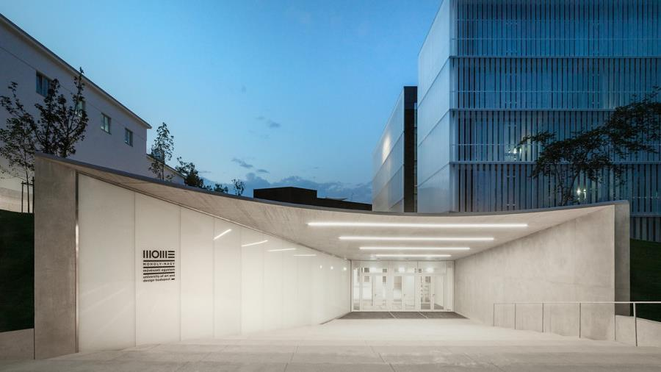
143
years

Slide 3
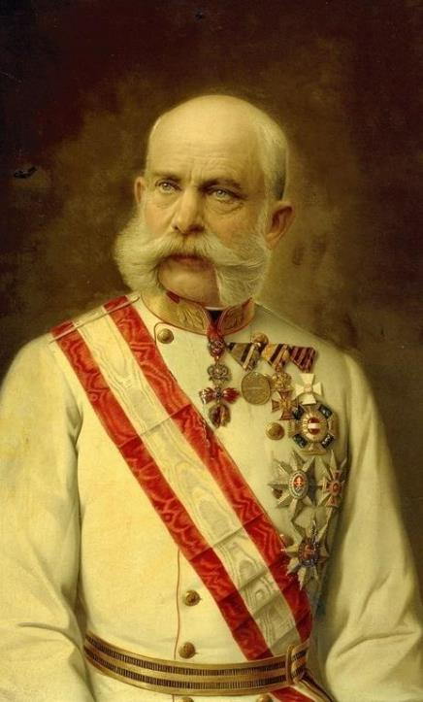
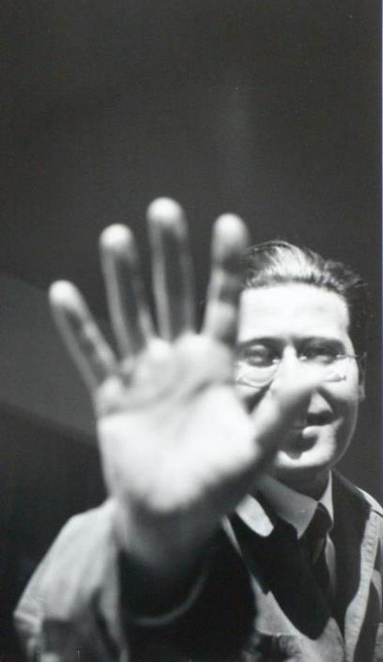
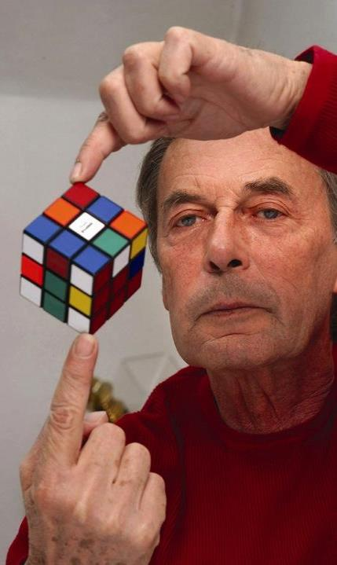
Franz Josef
László Moholy-Nagy
Ernő Rubik
Notes:
Országos Magyar Királyi Iparművészeti Tanoda, 1880
2005: MOME

Slide 4
MOME as creative ecosystem
Academia
education, research, innovation and business development within one single ecosystem
Innovation
Centre
TechPark
community

Slide 5
Global Challenges
ENVIRONMENTAL
climate change
soil degradation
biodiversity loss
plastic pollution
global warming
agriculture
food waste
textile waste
air pollution
deforestation
food and water insecurity
energy resources
education
migration
transport
overpopulation
production
pandemics
urbanisation
SOCIETAL
housing
geopolitics
aging society
access to energy
inequality
households’ energy
safety
healthcare
diversification
isolation
ENERGY

Slide 6
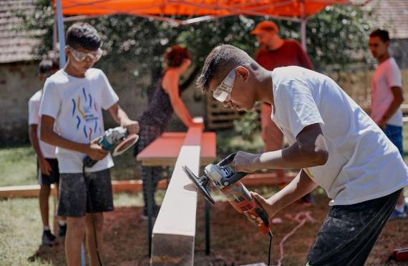
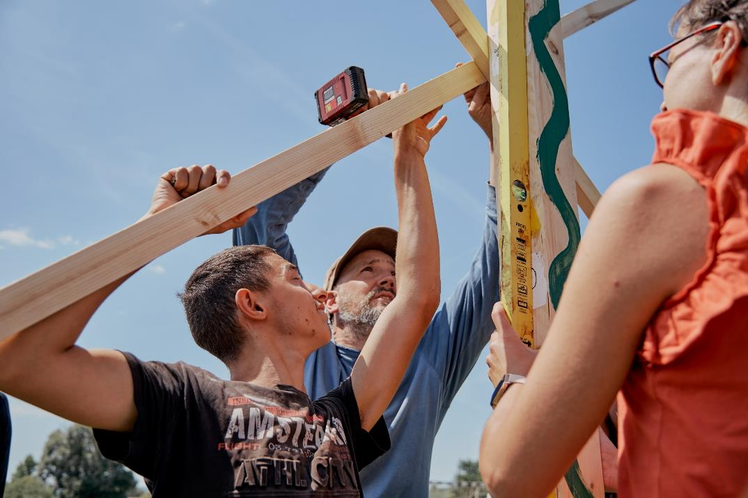
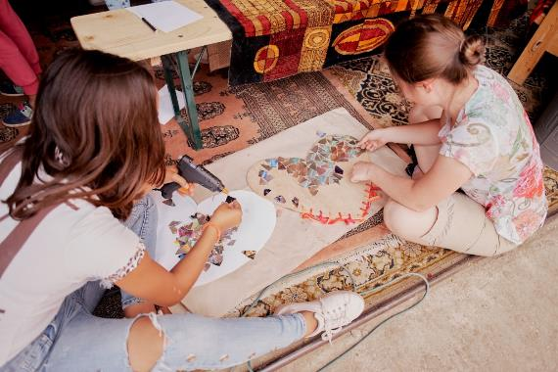
MOME x Hungarian Charity Service of the Order of Malta: Social Design Field Lab
Development of the creative competence of children in the 300 most impoverished villages of Hungary

Slide 7
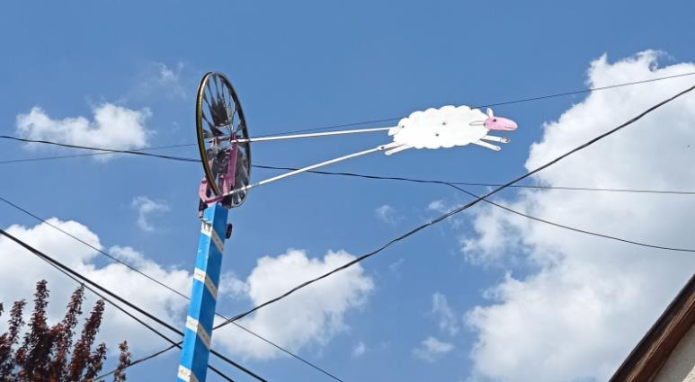
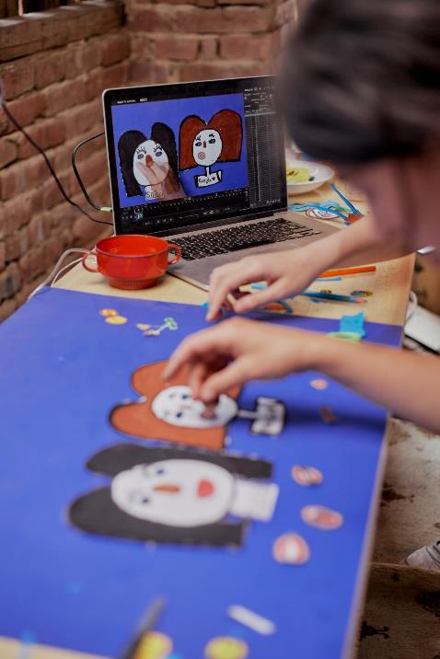
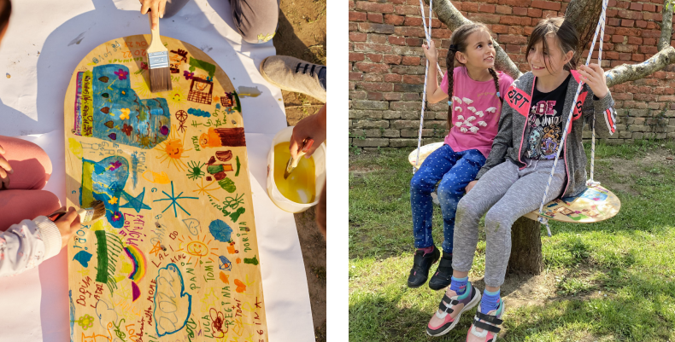
MOME x Hungarian Charity Service of the Order of Malta: Social Design Field Lab Zalakomár
Hackathons for building trust
Summer university for elaboration
Series of short workshops for
reverse verification
Design package for remore presence
Notes:
Hackathon: wind wheel / gossip bank / stop-motion animation

Slide 8
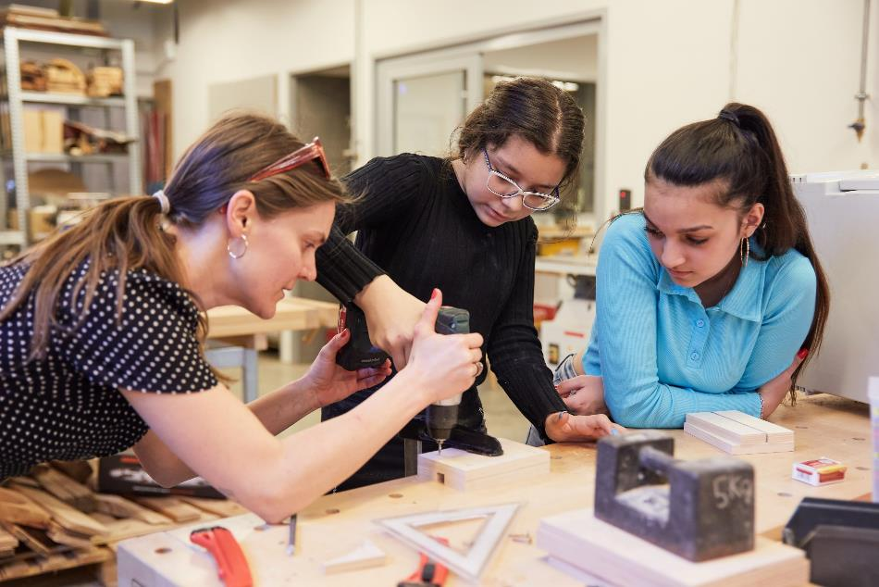
FRUSKA project
Unique design methodology and interdisciplinary design workshop for disadvantaged young girls (age 10-18) helping their social mobility and self awarness
participatory design
mutual learning
creative skill development

Slide 9
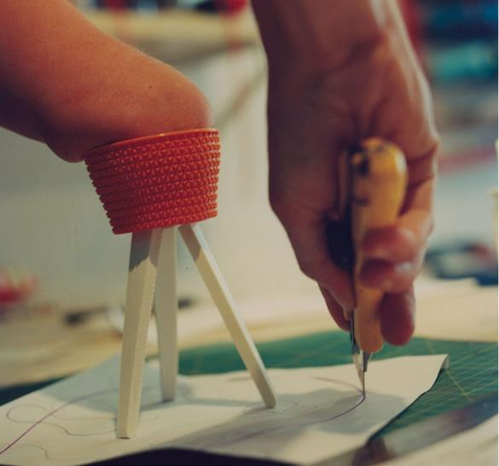
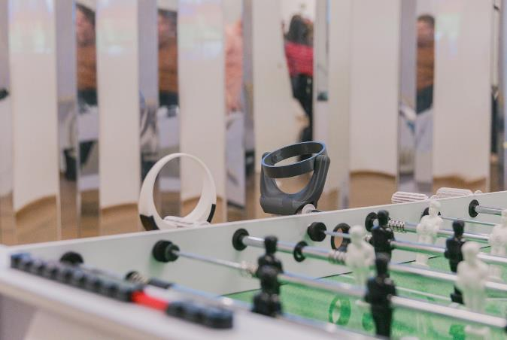
Co-Design with People with Disabilities
Co-Ability
3D printed protesis as an R&D project to combine disability, technology and design using co-design methodology framework.
The prosthesis that does not follow the anatomical shape of the body, but are used as useful tools in the process and presents the role of the designer not as an external expert, but as a research participant.
”Handle it!” Inclusive Tools
Most products for people with disabilities are aimed at providing basic needs, but this leads to a limited life. In most cases there are no products for recreation and entertainment, which is the basis of inclusiveness.
The product is a device that enables people with limb deficiencies to play table football.

Slide 10
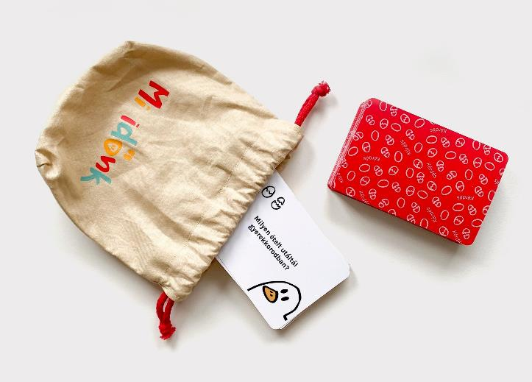
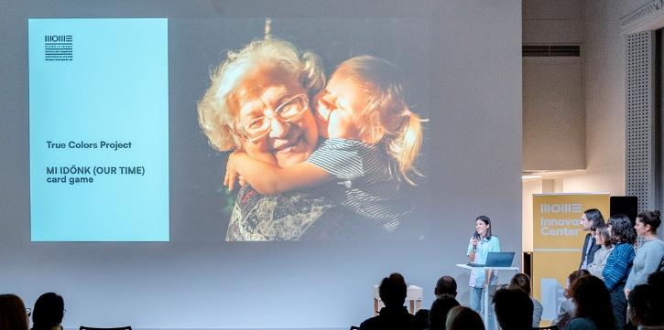
”Our Time” Card Game
”Our Time” card game brings grandparents and grandchildren closer, by facilitating communication and interaction and to initiate a dialogue between the age groups.
This is achieved through questions and exercises related to the lives of both generations.
The student project was incubated by MOME Proof of Concept Incubation Program in 2022.
Our Time

Slide 11
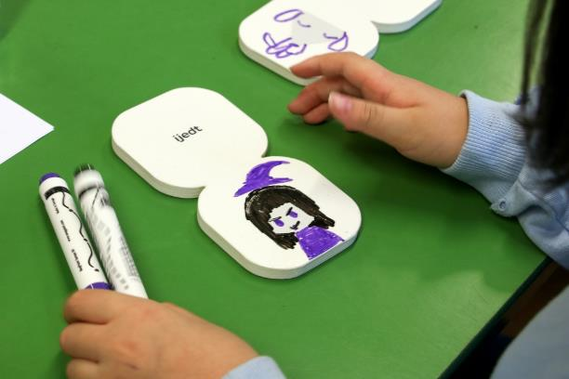
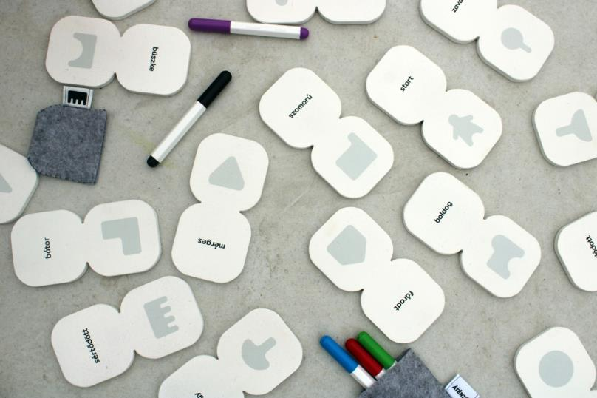
Diploma: ”Empatic” Card Game
”Empatic” is an educational game to strengthen empathy of young children by inviting them to tell a story together and focuses the narrative on the emotions of the characters.
Players aim to empathise with the character's emotions and proceed accordingly through a story-map reminiscent of dominoes.
Varga Boglárka

Slide 12
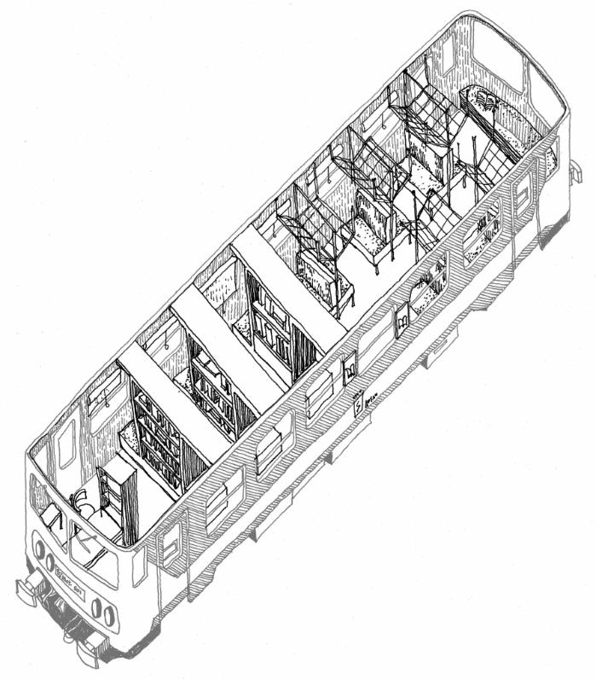
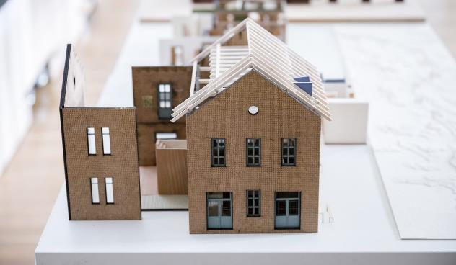
Diploma: Revitalisation of the remote railway line nr. 78
Regional development with design means
Free access to basic services is a human right in urban and rural areas.
Access can be facilitated for people living in small rural villages by the infrastructure of railway wings.
These currently underused lines could, with minor modifications, be able to accommodate missing services (e.g. doctor, post office, grocery store).
Laki Ábel

Slide 13
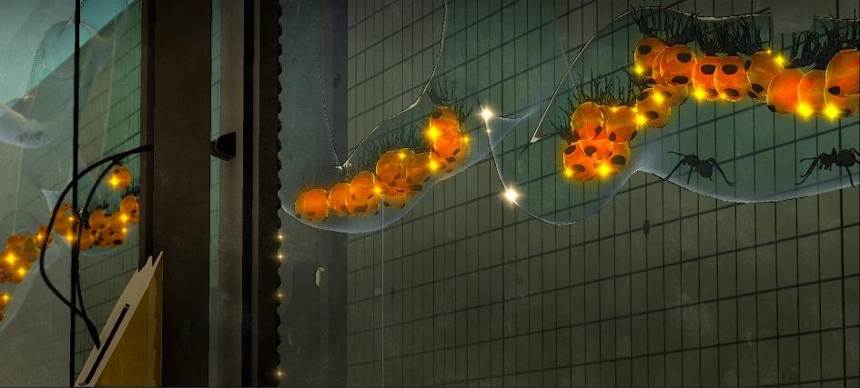
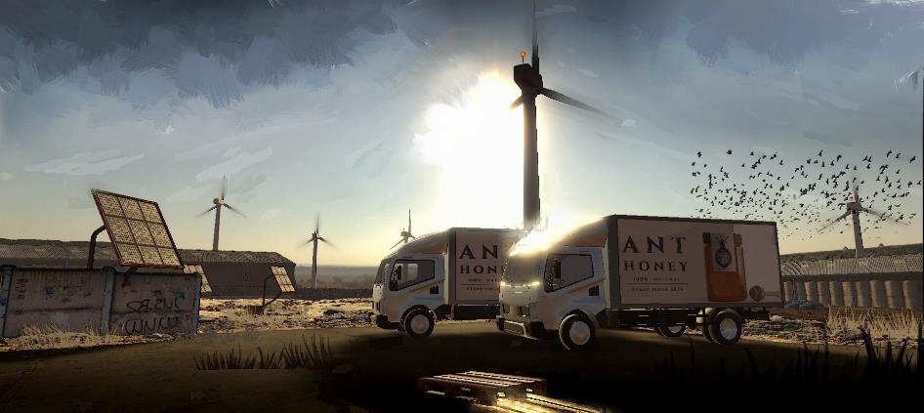
Honey Ant Farm in the Great Plain in 2050
Speculative design methodology to design a social/economic solution In a perfectly deserted ecosystem by 2050
Bees are extinct by 2050 as result of climate change, new ant species to produce honey (Myrmecocystus)
The concept designs a whole ecosystem and business model for a ant farm „bringing back the nostalgic taste of honey to the breakfast table”.
The farm, the system and the products are designed Botond Levente Kiss.

Slide 14
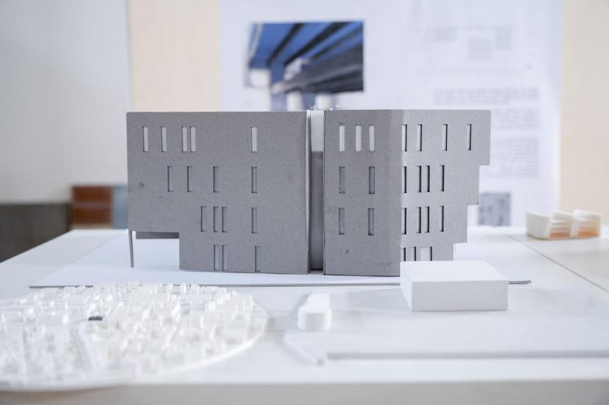
Diploma: Abandoned furniture store as cultural and scientific incubator
The diploma work focuses on the re-imagining of the former Domus furniture store as an education, knowledge and sports centre.
The aim was to infuse the building, originally a closed box, a furniture store, with transparent community functions, while maintaining the original character of the building.
A community living room, a safe interior world was planned where individuals and communities can relax, work, play sports, create, learn, grow and build new communities.
Bitter Fruzsina

Slide 15
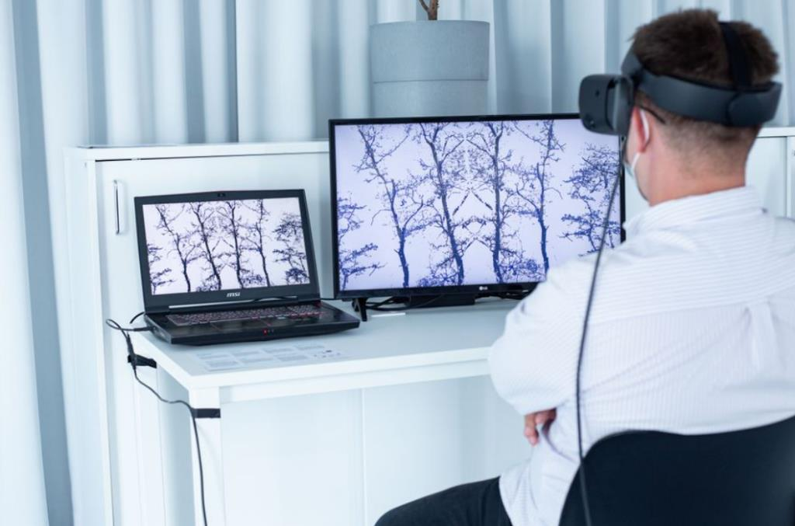
Zenctuary research project
Development of a 3D VR natural environment prototype that simulates the positive emotional and attentional restorative effects of the real natural environment in virtual reality.
The prototype is an interactive experience where people can perform various gardening interactions (e.g. watering, apple picking) in a garden, allowing users to interact with nature in a non-game-like way and create healing gardens.
Pilot: with individuals diagnosed with ADHD, focusing on the usability of the environment and the emotional changes of the participants.
It will be extended to clinical use in the next research phase.

Slide 16


Thank you
for your attention.
The rightholder of the presentation, including all texts, illustrations and images is Moholy-Nagy University of Art and Design Budapest. Their use in any way, including but not limited to the application in other material, public performance and communication to the public requires the permission of the rightholder.

