Slide 1

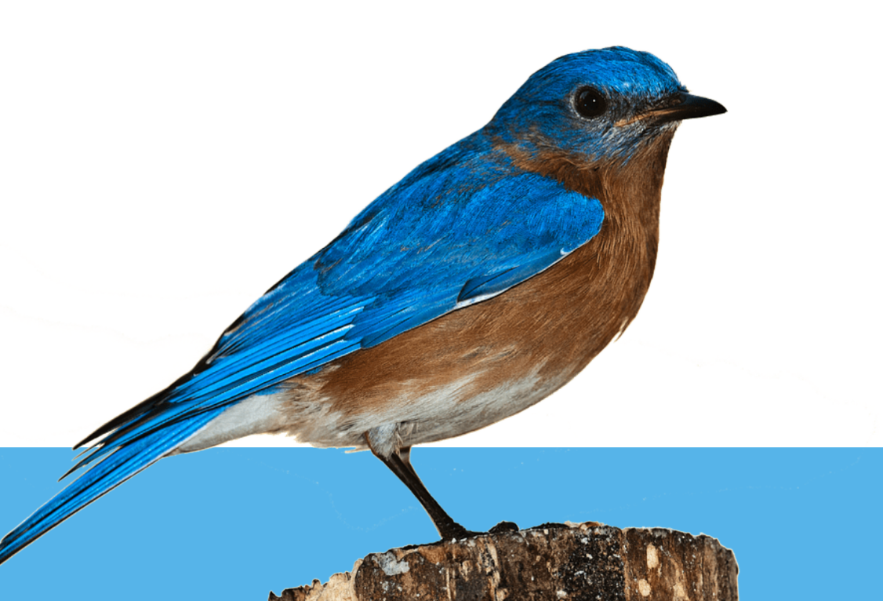
Social Innovations in a time of permanent crisis
- The Role of universities
Kinga Szabó-Tóth, Phd, habil.

Slide 2




Slide 3

What we have…
Constant crisis?
In his book published in 1986 (in Hungarian in 2003), Ulrich Beck suggests that in modern industrial societies risks arise that are no longer local, cannot be linked to time and space, so they are difficult to predic, they are not subject to causality and a question of responsibility.
Modern consumer societies also mean that there are more and more new types of stressors in the life of human communities that they have to deal with in one way or another. According to Pikó (2002), one of the most common coping strategies of our time is to deal with the stress situation as quickly as possible and with as little effort as possible – in many cases this can lead to the development of various addictions.
Learned helplessness (Kopp, Hankiss)
It would take learned ingenuity and wealth of resources!
Personal effectiveness: our belief in how well we can handle difficult situations
Low level of trust
Feeling out of control
Sense of incoherence
Chronic stress
Feeling vulnerable
Life grows beyond us
Avoiding uncertainty
Diverse communities, but rapidly changing
Flâneur mentality
Crisis and coping strategies (Erikson, Caplan, Lazarus and Folkman, etc.)-creative tension
Permanent Crisis. The Humanities in a Disenchanted Age - Paul Reitter and Chad Wellmon, 2021

Slide 4
challenges
Buildling from the „lack”
Sustainability
„Small is beautiful!”
Resistancy and resiliency
Integration - powerty
Areas: environment, deep adaptation, social enterprises, aging society

Slide 5
In recent years, novel solutions have been developed to catch up underdeveloped regions, which can be interpreted as social innovation.
In addition, an increasing number of social enterprises are registered as building blocks of solidarity and the social economy.
To sum up

Slide 6

Image SLide
What is Social Innovation
?
A new combination of social practices that can lead to a higher level of satisfaction for social needs. (Howaldt et al., 2014).
A novel combination of social practices, a higher level of cooperation, which can help increase the willingness of different groups in society to cooperate. The latter can contribute to reducing social disparities and meeting needs that cannot be met by the market. (Rehfeld et al., 2015).
Social innovations are also micro-regional organizations
that emerged as a bottom-up initiative in the first half of the 1990s and became part of the implementation of regional innovations. (Éva G. Fekete, 2001).
Social innovation is any new approach, paradigm and related product, process, practice, network that differs from the previous practice, which aims to solve the problems and needs that arise in society, while creating new values, attitudes, new social relations, possibly new structures will be created. (Nemes – Varga, 2015).
Social innovation is the development and implementation of new ideas (product, service, model) that meet social needs and create new social relationships or collaborations. In this way, it can provide a solution to problems that affect social processes and, as an ultimate goal, improve the well-being of a given area. (European Commission, 2013).

Slide 7
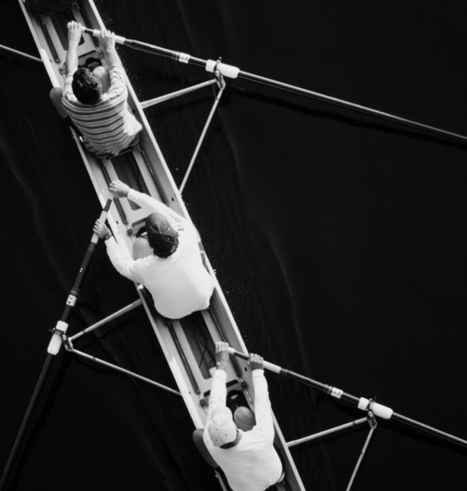
The „map” of Social Innovations
INNOVATIONS
aims:
financial sources/ feasibility:
players/generators:
modes of appearance:
shaping attitude
changing the status quo
shaping identity
deliver and conserve value
deliver know how
provide novel, effective solutions
know -how, process, technology
new kinds of cooperation
product, service, institution, organization
marketing, brand, image
communal finance
voluntary work
state, local governmental
private/family financing
church
civil organizations
EU
individuals/families
local government, state
research groups
civil organizations
religious organizations
impacts:
transmission of cultural traditions
social integration
community development
stronger local identity
stronger ties between generations
improvement of the quality of life
scopes:
economic
cultural
social
welfare
Source: Kinga Szabó-Tóth

Slide 8
Steps for generating social innovations
Exploration
aimed study
stop/look/listen/learn
get to know the environment
Identification
Connection
Changing the status quo
Connection
Feedback, action
start small and test it
testing reactions
it is okay to make mistakes
Actions
Finding alliances
common platform
interdisciplinary team
attune to success
Cooperation and dissemination
the real problem
with the community
keep talking start doing
diversity
Source: Kinga Szabó-Tóth

Slide 9
Universities and
social innovations

Slide 10

By the end of the 20th century, higher education institutions were faced with many new challenges, mainly with the fact that in addition to their traditional activities - such as education and research - additional functions were created in accordance with changing socio-economic expectations.
This activity is matched by the third mission activity of higher education institutions, otherwise known as the "service university" concept.
According to some ideas, the ideal type of university at the end of the 20th century is the so-called "third generation" university, which realizes the synergy of education, research and social involvement.
According to others, the so-called "fourth generation" universities are already appearing in the 21st century higher education, which not only respond to their socio-economic environment, but also actively shape it themselves.
The so-called "third mission" summarizes the connections between higher education institutions and their environment, the activities and their effects on their social and economic environment (even through its formation and shaping) and means that all institutionalized relationships maintained with partners in the non-academic world comply with the principles of sustainability and environmental protection keeping in mind.
The important elements of the concept are the active dialogue with society, the accountability of the higher education institution towards the actors of social and economic life and keeping in mind the principles of sustainable human development (Larrán - Andrades, 2013, cited by Jorge - Peña, 2017).
COPING STRATEGIES

Slide 11


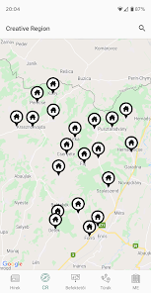
Some examples from our practice
“
HANDS - Cooperation between higher education institutions in Northern Hungary (2014)
Social innovations in the service of social catching up:
Social Innovation Cluster
General goal:
Circles of innovation
TÉRERŐ Community Foundation (2016)
Designed to pool donations into a coordinated investment and grant making facility dedicated primarily to the social improvement of a given place.
Act as grant-making foundations – give grants to support development local projects
Mentors for social innovations
Training of social innovation for professionals
Workshops of regional actors
Generating social innovations in BAZ county (2015) T-modell
To use the training and research experience accumulated in higher education in the development of rural areas struggling with persistent crisis problems, thus ensuring direct knowledge transfer between higher education and regional development practice
Helps in the development of local innovative initiatives
Institutional Excellence Program for Higher Education
Social and cultural innovations for regional economic development and catching up
˙”Abaúji App”
Cultural values of the region
Disseminating the idea of SI
Helping setllements to be more visible (wikipedia articles)
Creative Region (2018-)
Notes:
independent registered philanthropic institutions serving geographically defined territory, typically a city or administrative area
Act as grant-making foundations – e.g. give grants to support development projects
Their mission broadly defined – e.g. to improve quality of life in a community
Serve geographically defined communities – a city, state, region, district or province
Are supported by a broad range of private as well as public donors and seek philanthropic contributions primarily from inside the community
Are governed by multi-sectoral, local boards reflecting the community
Build capital endowment, which is an important element of sustainability
In the Creative Region project, under the direction of Mária Illésné Kovács, Dean (BTK), 4 faculty researchers and instructors are involved, the main task of the BTK working groups is the cultural treasury concept development of the methodology to be used in the research, modeling. The project work is carried out in working groups, the research is carried out for 27 Cserehát settlements in the Encsi Micro-Region, that is, it covers a part of the historical Hungarian villages of Abaúj. Within the framework of the program, a mobile phone application called Abaúji App was developed, which a contains the most important socio-demographic, historical and geographical data of settlements and It also offers hiking trails to the area. The program is still ongoing. In the context of the current tasks, the wikipedia articles are available in several languages ​​and in the region we carry out health promotion, community development and local identity strengthening activities.
When working on the local innovation
potential (LIP) index we present in this study, we drew
upon existing theories and models of social innovation.
The complexity of the LIP index comes from the fact that
it builds upon both qualitative and quantitative data and
research methods. Therefore it is simultaneously based on
social scientific methods that are traditionally considered
“soft” and “hard”.
As a starting point we focused on the fact that
settlements and communities can be multifaceted,
meaning that the LIP index should also be. The LIP index
is fitting to take local specificities, local characteristics into
account and by doing so it is able to take for presenting a
fine-tuned description of the current situation and
characteristics of a settlement, together with its future
potential and directions in development.
The basic model has been formed by building on
previously existing models. We wanted it to have more
pillars (as, in an ideal case, settlements also have more than
onestrength to draw upon) and to reflect one of the most
important characteristics of innovation: diversity. We also
wanted the model to be suitable for applying quantitative
and qualitative methods and approaches and for building
on different data sources. It was also important to form a
model whose indicators are available and measurable in
every settlement in focus. We observed the criteria of
validity and reliability and also the need for a standardized
measurement tool. The model rests on four pillars: (1)
local courage (LC); (2) human resources potential (HR);
(3) economic potential (EP) and (4) cultural and natural
“resources” (CNR)

Slide 12
Some examples from our practice
“
(Active Aging project 2022)
Interreg V-A Slovakia-Hungary Cooperation Funded by the program "Active Aging - Improving the quality of life of the elderly in Slovakia and Hungary" project (project number: SKHU 1902/4.1/101) represents an innovative approach, the aim of which is primarily improving the quality of life of the elderly through practicies..
(Biomass project 2011-2012)
(Firelife project 2017-2019
Development of a biomass-based settlement energy system began its preparation in the town of Csernely in the summer of 2011.
A comparative study of the sociological background of forest fires in
(4IM project 2021-2023)
VP/2020/003/0218 "Initiative for innovative integrated interventions in Miskolc - 4IM (Miskolc shall be a place for everyone!)
B-A-Z counties on behalf of the Forestry Directorate of the National Food Chain Safety Office.

Slide 13
FUTURE
New governance - In this case, the essence of innovation is that self-governance is not carried out by an isolated process separate from citizens, but an attempt to collaborative work. We need a new governance model that is holistic and where the role of citizens in the implementation of social processes increases – participatory democracy
The key question of managing social innovation is to connect vertically separated networks while securing their autonomy and ability to resist and being resilience.
Learning communities – community-based innovation:
  building stones (Bradford 2003:9–11):
  local "racers" (other literature calls them "local heroes");
  equal and comprehensive participation of local actors;
  a culture of innovation and creativity (others call it "openness to the new„)
  sufficient technical and financial resources;
  accountability to local partners

Slide 14
Thank you for your attention!
Thank you for your attention !
„a swallow does not make a summer”
….but it can be a starter for a new beginning!

Slide 15
Kinga.szabo.toth@uni-miskolc.hu

