Slide 1



Social Innovation Plus – Competence Centres
Jörg Mirtl
L&R Social Research, Vienna
Budapest, 3 July 2023

Slide 2
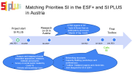


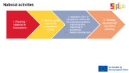
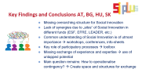
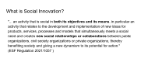
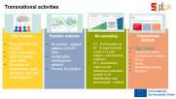
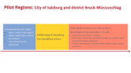
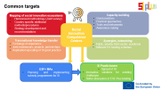

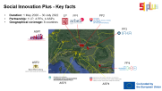
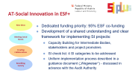
Contents

Slide 3
What is Social Innovation?
"... an activity that is social in both its objectives and its means, in particular an activity that relates to the development and implementation of new ideas for products, services, processes and models that simultaneously meets a social need and creates new social relationships or collaborations between public organizations, civil society organizations or private organizations, thereby benefiting society and giving a new dynamism to its potential for action."
(ESF Regulation 2021/1057 )

Slide 4


Key Facts
SI PLUS – Competence Centre for Social Innovation
Duration: May 2021 to July 2023
Geographical Coverage: 8 Countries
Lead Partner: L&R Social Research, Austria in cooperation with the project partner arbeit plus
Transnational Partners: IFKA Hungary, ESF Managing Authority Slovakia, SDA Bulgaria
Associated Partners: ENSIE and the ESF MA of Baden-Württemberg, Croatia and Slovenia

Slide 5




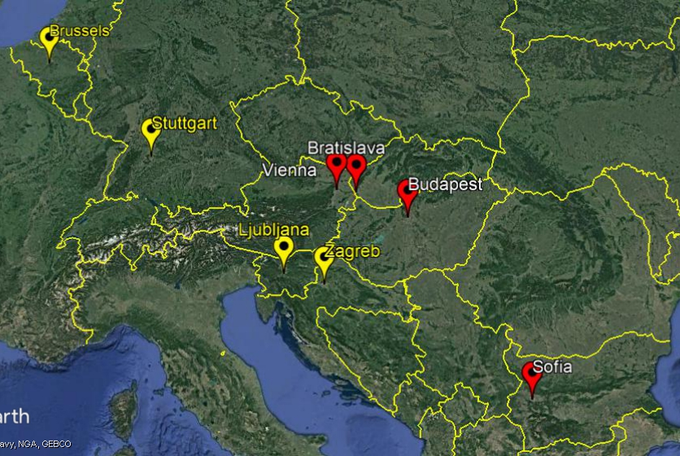






Social Innovation Plus - Key facts
Duration: 1 May 2020 – 30 July 2022
Partnership: 1 LP, 4 PPs, 4 ASPs
Geographical coverage: 8 countries
LP
PP1
PP2
PP3
ASP1
ASP2
PP4
ASP3
ASP4

Slide 6

Common targets
Mapping of social innovation ecosystems
Harmonized methodology (Joint survey)
Country-specific additional methods/procedures
Strategy development and recommendations
Capacity-building
Good practices
Practical approaches
Tools and instruments
Awareness-raising
Social Innovation Competence Centres
Transnational knowledge transfer
Exchange of experience
Joint endeavours, projects, partnerships
Replication/upscaling of SI good practice
Synergies, networking
Public, private, third sector, academia
Different EU funding schemes
ESF+ MAs
Planning and implementing subsidy programmes for SI
SI Practicioners
Spread of SI
Innovative solutions for existing challenges
Better absorption of ESF Plus funding

Slide 7

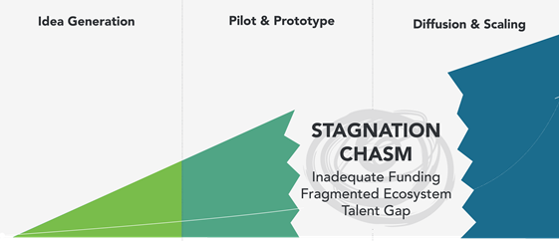
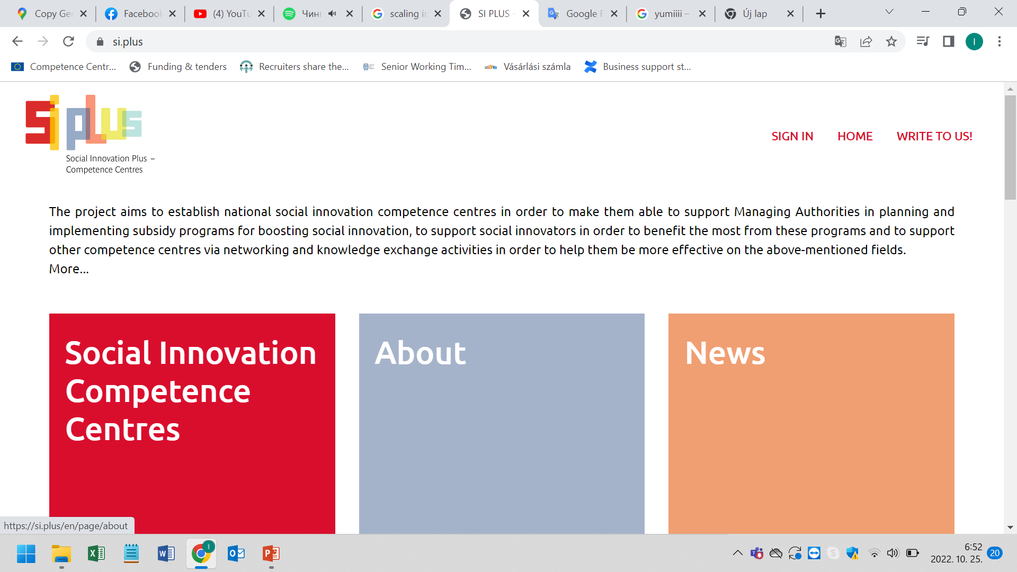
Transnational activities
Peer learning
Peer pairs (AT-SK, HU-BG)
Joint action plans
Staff exchange, peer visits
Exchange of experiences, good practices, site visits, mutual support
Thematic networks
SI policies - support network of ESF+ MAs
Sustainable development network
Poverty & Inclusion
Re-/upscaling
AT: „Participation as SI”. SI experimental rooms in 2 pilot regions, participatory methods
HU: MarketMate online social enterprise evaluation system in SI identification and assessment - contest
Transnational platform
https://si.plus/
Social Innovation Competence Centres
About
News
Knowledge Centre
Partners

Slide 8
National activities
1. Mapping –
National SI Ecosystems
3. Integration of the SI competence centres into the national ecosystems
Supporting MAs
Supporting SI practitioners
Network development
2. Setting up the national SI competence centres
4. Strategy development and action planning

Slide 9
Matching Priorities SI in the ESF+ and SI PLUS in Austria
2 Pilot regions in AT:
Tools & Know-How on participatory processes
Map(s) of reg. needs
Calls IB
Project start
SI PLUS
Final
Toolbox
Research on SI in Austria
n AT
May 2021
Q3-2021
Q4-2021*
Q4-2022
Q1-2023*
July 2023
Analysis and mapping of social innovation approaches, initiatives, methods and projects
Survey on social needs created by Covid-19
Website with knowledge base
Networking structures
Capacity Building (workshops and conferences)
Toolbox: Guidance papers and check lists
Joint blueprint for SI in ESF+

Slide 10
AT-Social Innovation in ESF+
Dedicated funding priority: 95% ESF co-funding
Development of a shared understanding and clear framework for implementing SI projects:
  Capacity Building for Intermediate Bodies, stakeholders and project promoters
    SI check list: 4 SI categories to be addressed
    Uniform implementation process described in a guidance document („Wegweiser“) - discussed in advance with the Audit Authority
New Ideas
Meeting Social Needs
Creating Collaborations
Benefiting Society

Slide 11

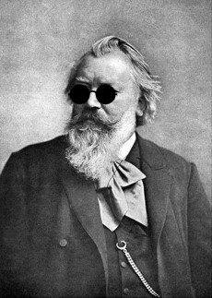

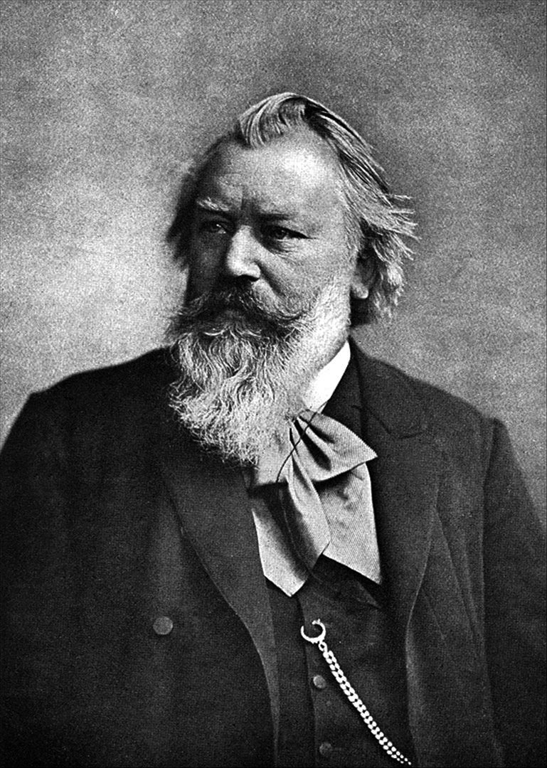
Austria: Two Pilot Regions

Slide 12
Pilot Regions: City of Salzburg and district Bruck-Mürzzuschlag
Framework & actor maps:
Who is active in the region?
Which stakeholders need to be involved?
How should they be addressed?
Addressing & involving the identified actors
Participatory processes for project development/preparation of calls
Forum Social Innovation, Salzburg
Workshops networking, individual info talks (e.g. specific target groups like leading companies) . . .
Toolbox “Participation” for Intermediate Bodies and for project promoters

Slide 13
Key Findings and Conclusions AT, BG, HU, SK
Missing overarching structure for Social Innovation
Lack of synergies due to „silos“ of Social Innovation in different funds (ESF, EFRE, LEADER, etc.)
Common understanding of Social Innovation is of utmost importance → workshops, conferences, info-sheets
Key role of participatory processes → toolbox
Missing exchange of experience and expertise → use of untapped potential
Main question remains: How to operationalise contingency? → Create space and structures for exchange

Slide 14
Social Innovation?
COORDINATION
UPSCALING
Policy
Policy
Programme
Programme
Project
Project

Slide 15

Thank you for your attention!
Jörg Mirtl
L&R Social Research
https://www.lrsocialresearch.at/
https://si.plus/

